Slide 2
AWS Secrets Manager – best practices for managing, retrieving, and rotating secrets at scale
SEC304
Apurv Awasthi
Sr. Product Manager
AWS

Slide 3
I don’t want to email secrets
I want to prevent developers from viewing or sharing secrets
I want to stop “secret sprawl”
I want visibility in to who used which secret, when
I want to enable teams to operate quickly, without waiting on the security team to create and provision secrets
I want to roll-out secrets safely
I want to rotate secrets without system downtime
SEC 304 – best practices for managing, retrieving, and rotating secrets at scale with AWS Secrets Manager

Slide 4
AWS Secrets Manager enables customers to manage, retrieve, and rotate database credentials, API keys, and other secrets throughout their lifecycle

Slide 5
IT Admins: store and manage access to secrets securely and at scale
Security Admins: audit and monitor the use of secrets, and rotate secrets without a risk of breaking applications
Developers: avoid dealing with secrets in their applications

Slide 6
What to expect from this session?
Understand the capabilities of AWS Secrets Manager
Learn how to adopt AWS Secrets Manager
Pro tips for managing secrets through their lifecycle at scale
Demos

Slide 7
Capabilities

Slide 8









Capabilities
Secure centrally
Fine-grained access control and auditability
Rotate secrets safely
Pay as you go

Slide 9
Secure
Stored centrally and retrieved programmatically
Encrypted by default using encryption keys owned by the customer
Support for VPC-endpoints via AWS Private Links
Integrated with CloudFormation
Support for client-side caching
Compliant with HIPAA
, PCI, and ISO
Create and store secrets so that developers don’t view or handle secrets

Slide 10
Sample command
aws secretsmanager create-secret --name TestApplication/MyTestDatabaseSecret
--description “Upload credentials for my test database from the CLI. Team Isengard owns this secret."
--secret-string file://mycreds.json
aws secretsmanager get-secret-value --secret-id TestApplication/MyTestDatabaseSecret

Slide 11
Fine-grained access control and auditability
IAM policies for fine-grained access control
Resource-based policies for cross-account access
Tag-based access control and hierarchical names for scalability
Integrated with CloudTrail, CloudWatch
Control access and audit use to prevent “secret sprawl”

Slide 12
Sample policy
{
"Version" : "2012-10-17",
"Statement" : [
{
"Effect": "Allow",
"Action": ["secretsmanager:GetSecretValue", "secretsmanager:DescribeSecret"],
"Resource": "arn:aws:secretsmanager:us-east-2:000000000000:secret: TestApplication/MyTestDatabaseSecret"
}
]
}

Slide 13
Rotate secrets safely
Built-in integrations for rotating all Amazon Relational Database Service (Amazon RDS) database types
Extensible with AWS Lambda
Use versioning so that applications don’t break when secrets are rotated
Pay for the API call; no additional charge for rotating secrets
Transform a long-term secret in to a short-term secret that is rotated automatically

Slide 14





How rotation works
AWS Secrets Manager
Application
AWS Relational Database Service (RDS)
GetSecretVaule command
{Ua, Pa}
{Ua, Pa}
{Ua, Pa}
Stage: AWSCURRENT
Data
MS SQL instance

Slide 15


How rotation works
AWS Secrets Manager
Application
AWS Relational Database Service (RDS)
VPC
GetSecretVaule command
{Ua, Pa}
{Ua, Pa}
{Ua, Pa}
Stage: AWSCURRENT
Data
Rotation Lambda Function
Create and validate new database credential {Ub, Pb}
MS SQL instance
{Ub, Pb}
Stage: AWSPENDING
Confirmation message

Slide 16
How rotation works
AWS Secrets Manager
Application
AWS Relational Database Service (RDS)
VPC
{Ua, Pa}
Stage: AWSPREVIOUS
Rotation Lambda Function
Stage: AWSCURRENT
GetSecretVaule command
{Ub, Pb}
MS SQL instance
{Ub, Pb}
{Ub, Pb}
Data

Slide 17
Pay as you go
No annual license or up front cost
30 day free trial for experimentation
$0.40 per secret per month (pro-rated based on the number of hours)
$0.05 per 10,000 API calls
Pay only for what you use

Slide 18
Demo
Code available at: https://bit.ly/2Qg3r85

Slide 19





Network diagram for demo
VPC
Public subnet 1
Bastion Host
NAT gateway 1
Internet gateway
Private subnet 1
Example Host 1
MySQL DB instance
NAT gateway 2
Example Host 2
Rotation Lambda Function

Slide 20
Adopting Secrets Manager

Slide 21
Adopting Secrets Manager
Remove plain-text secrets
Rotate frequently
Retrieve programmatically
Lock down permissions
Use unique secrets
Audit and monitor the use of secrets

Slide 22
Adopting Secrets Manager
Remove plain-text secrets
Rotate frequently
Retrieve programmatically
Lock down permissions
Use unique secrets
Audit and monitor the use of secrets

Slide 23
1. Remove plain-text secrets
Benefits
Reduce risk of misuse
Reduce “secret sprawl”
Reduce overhead on developers
How to get started
Pick an account strategy – manage secrets in a central account or across multiple accounts
Find where secrets are being used
Automate migration using AWS CloudFormation or custom tools
Pro tip:
Operate Secrets Manager in each AWS account
Define practices for naming, retrieving, encrypting, and rotating secrets
Sanity check the number of secrets

Slide 24
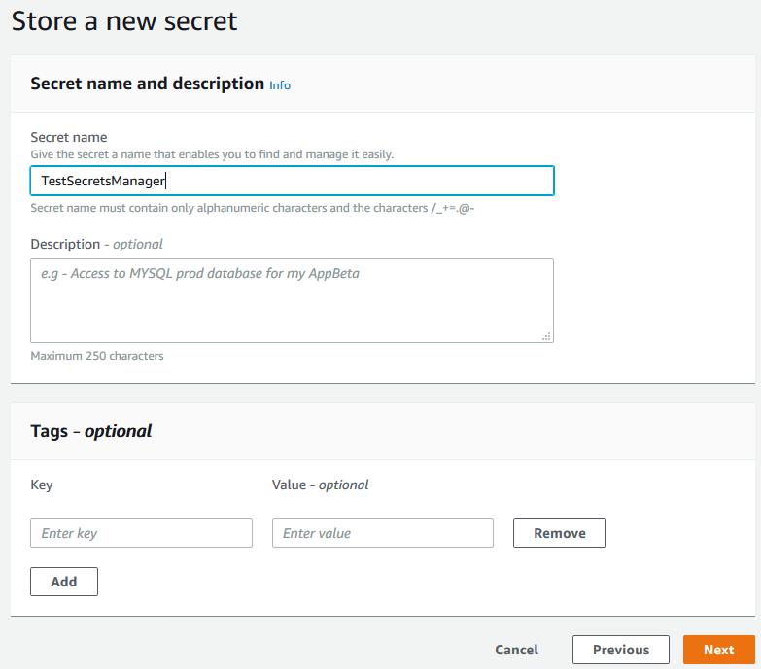
Define practices for naming
Good practice
Poor practice

Slide 25
Define practices for naming
Good practice
Poor practice
Instead
Use names that are meaningful
Hierarchical names (e.g., prod/MyMobileApp/MySQL) are scalable
Use description to record details about this secret
Use tags to group secrets and manage these easily at scale

Slide 26
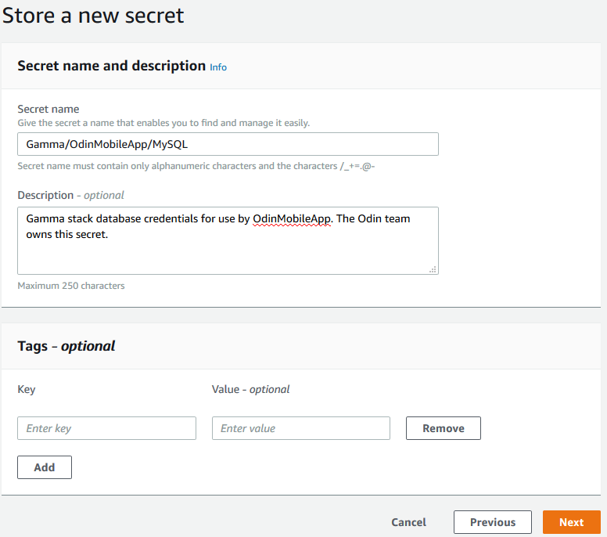
Define practices for naming
Good practice
Poor practice

Slide 27
Define practices for naming
Good practice
Poor practice

Slide 28
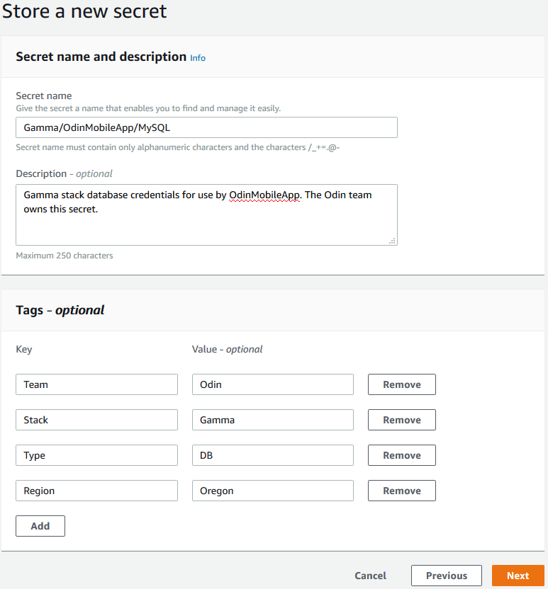
Define practices for naming
Good practice
Poor practice

Slide 29
Define practices for naming
Good practice
Poor practice
“Statement": [
{
"Sid": “RequireTagWhenYouCreateSecret",
"Effect": "Allow",
"Action": [
“secretsmanager:CreateSecret“
],
"Resource": "*",
"Condition": {
"StringLike": {
“SecretsManager:RequestTag/Team": "*"
}
}
}
]

Slide 30
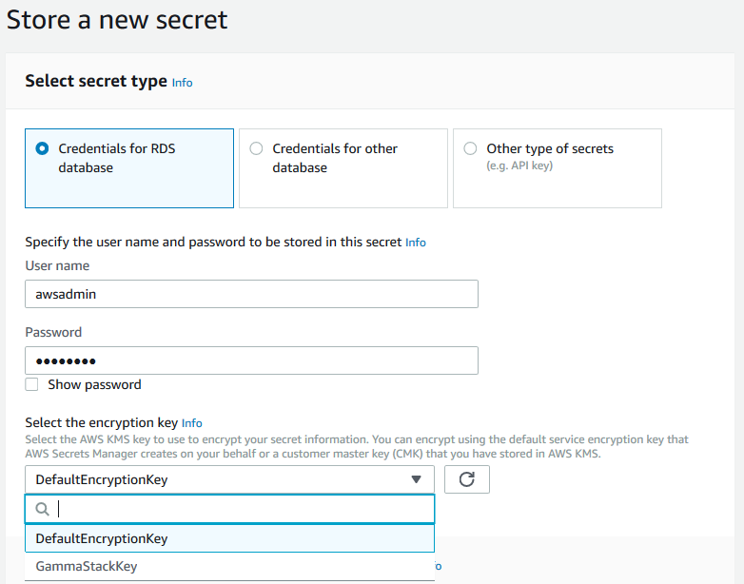
Define practices for encryption
Good practice
Poor practice
Depends
Default service key
Unique key for each account and region
No overheard of managing AWS KMS permissions
Customer master key (CMK)
Unique compliance or security requirements
Required for cross-account access to secrets
Another set of access control

Slide 31
Adopting Secrets Manager
Remove plain-text secrets
Rotate frequently
Retrieve programmatically
Lock down permissions
Use unique secrets
Audit and monitor the use of secrets

Slide 32
2. Rotate frequently
Benefits
Improve security
Follow best practice
How to get started
For existing applications, first migrate the secret, then configure rotation
For new applications, set up rotation from the start
Create the rotation lambda function
Pro tip:
Use the default frequency of 30 days; check your compliance and security requirements
Pay for APIs and use of Lambda; no extra charge for rotation
Rotation Lambda functions must be able to communicate both with the protected resource (e.g. a database) and with Secrets Manager
Use VPC end-points
Update the password policy according to your downstream systems
Reuse rotation Lambda functions

Slide 33
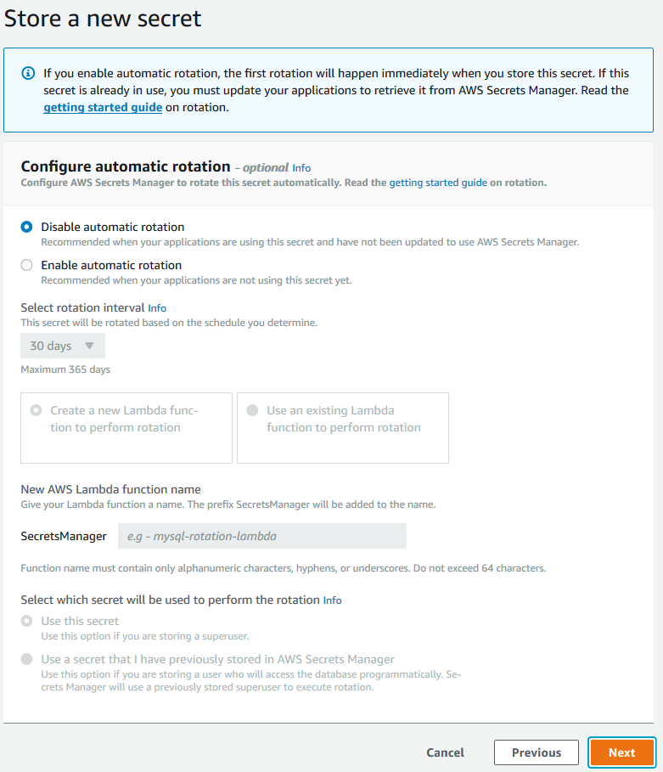
Rotate frequently
Good practice
Poor practice

Slide 34
Rotate frequently
Good practice
Poor practice
Set up rotation ASAP

Slide 35
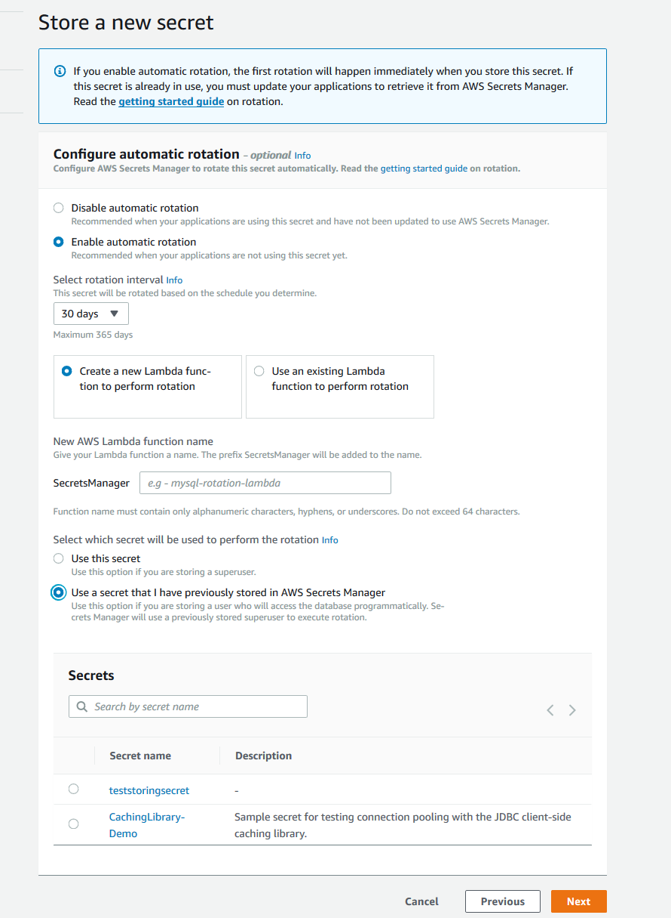
Rotate frequently
Create new Lambda
Reuse existing Lambda

Slide 36
Rotate frequently
Create new Lambda
Reuse existing Lambda
Easier to separate IAM permissions from Secrets Manager permissions
Easier to manage a small number of rotation lambda functions

Slide 37
Rotate frequently
Use this secret
Use previously stored secret

Slide 38
Rotate frequently
Use this secret
Use previously stored secret
Rotate between credentials for two database users

Slide 39
Adopting Secrets Manager
Remove plain-text secrets
Rotate frequently
Retrieve programmatically
Lock down permissions
Use unique secrets
Audit and monitor the use of secrets

Slide 40
3. Retrieve programmatically
Benefit
Developers don’t have to view or manage secrets
How to get started
Create IAM roles for you applications
Grant these IAM roles the ability to retrieve secrets
Update code to call GetSecretValue API
Pro tip:
Retrieve every hour
Use client-side caching libraries, or develop your own SDK, for example similar to Spring Cloud SDK
Place the code to retrieve outside the Lambda handler
Schedule for deletion

Slide 41
Example: C3P0 connection pooling via Spring
<bean id="employeeDataSource" class="com.mchange.v2.c3p0.ComboPooledDataSource" destroy-method="close">
<property name="driverClass" value="com.mysql.jdbc.Driver" />
<property name="jdbcUrl" value="jdbc:mysql://my-dummy-rds-instance.rds.amazonaws.com:3306" />
<property name="user" value="user" />
<property name="password" value="password" />
</bean>
Spring
<bean id="employeeDataSource" class="com.mchange.v2.c3p0.ComboPooledDataSource" destroy-method="close"> <property name="driverClass" value="com.amazonaws.secretsmanager.sql.AWSSecretsManagerMySQLDriver" /> <property name="jdbcUrl" value="jdbc-secretsmanager:mysql://my-dummy-rds-instance.rds.amazonaws.com:3306" /> <!-- The property below can take a secret-id as ARN or friendly name --> <property name="user" value="demo-secret" /> </bean>
Client-side
caching

Slide 42
Adopting Secrets Manager
Remove plain-text secrets
Rotate frequently
Retrieve programmatically
Lock down permissions
Use unique secrets
Audit and monitor the use of secrets

Slide 43
4. Lock down permissions
Benefits
Support least privileges
Less chance of human mistake
How to get started
Identify who needs what access
Define IAM policies
Use resource based policies for cross-account access
Pro tip:
Tightly control secretsmanager:* permissions
Grant ListSecrets and DescribeSecret permissions
Configuring rotation requires IAM permissions
Separate storing, retrieving, and configuring rotation tasks
Use tags to group secrets
Use tag-on-create to make secrets management self-service
Cross-account access requires CMKs

Slide 44
Adopting Secrets Manager
Remove plain-text secrets
Rotate frequently
Retrieve programmatically
Lock down permissions
Use unique secrets
Audit and monitor the use of secrets

Slide 45
5. Use unique secrets
Benefits
Minimize blast radius
Easily recover in restart or DR scenarios
Minimize overhead of synchronizing secrets
How to get started
Use CloudFormation or other tooling to provision secrets
Require applications to retrieve secrets from the regional Secrets Manager end-point
Pro tip:
Use unique secrets per environment, per AWS Region, per account

Slide 46


Use unique secrets
AWS Region – US West 2 (Oregon)
AWS Region – US East 2 (Ohio)
Replicate
MS SQL instance
MS SQL instance
GetRandomPassword
{Ua, Pa}
GetRandomPassword
{Ua, Pb}
{Ua, Pa}
Data
{Ua, Pb}
Data
GetSecretVaule
Replicate
GetSecretVaule
{Ua, Pa}
{Ua, Pb}
AWS Secrets Manager
Application
AWS Secrets Manager
Application

Slide 47
Adopting Secrets Manager
Remove plain-text secrets
Rotate frequently
Retrieve programmatically
Lock down permissions
Use unique secrets
Audit and monitor the use of secrets

Slide 48
6. Audit and monitor the use of secrets
Benefits
Support least privileges
Less chance of human mistake
How to get started
Quick glance – IAM Access Advisor
Auditable records – AWS CloudTrail Logs
Monitor use – Amazon CloudWatch Events
Pro tip:
Monitor attempts to retrieve secrets that are scheduled for deletion
Monitor high value secrets
CloudTrail records all Secrets Manager API calls; expect an increase in the size of your trails

Slide 49
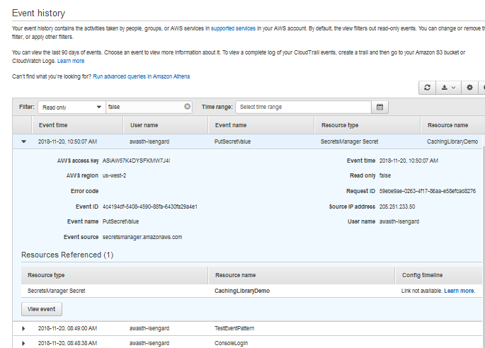
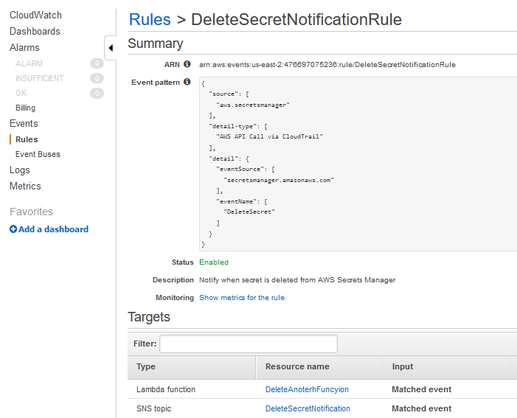
Audit and monitor
AWS CloudTrail
Amazon CloudWatch Events

Slide 50
Demo
Code available at: https://bit.ly/2FE8YB6

Slide 51

Network diagram for demo
VPC
Public subnet 1
Public subnet 2
Bastion Host
NAT gateway 1
NAT gateway 2
Private subnet 1
Private subnet 2
CloudFormation VPC Endpoint
CloudFormation VPC Endpoint
Example Host 1
MySQL DB instance
Secrets Manager VPC Endpoint
Example Host 2
Secrets Manager VPC Endpoint
Rotation Lambda Function

Slide 52
Apurv Awasthi
Email: awasth@amazon.com
Twitter: @awasthi_av
(or, the blackjack tables at Treasure Island)

